Slide 1
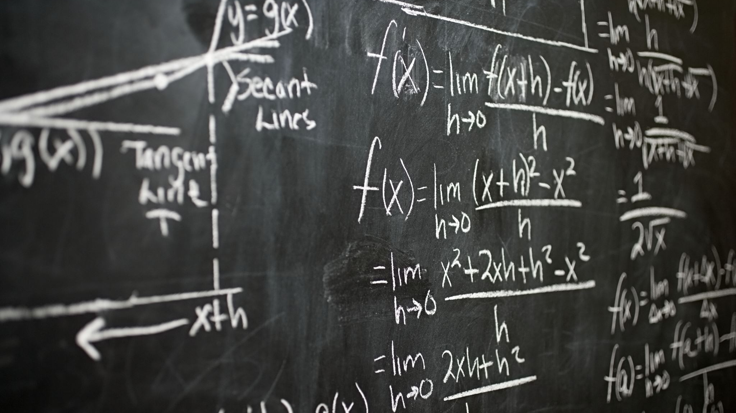
Summer Math
Academy
2024

Slide 2
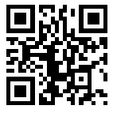
Summer Math Academy
Help prepare you for your fall entrance to college
Strengthen your math skills
Better prepare you for college life and survival
Introductions
Steve Francis – Professor of Mathematics
Announcements
Student Intake Survey https://tinyurl.com/4xtrbf7k

Slide 3
Commonality
Write First Name under Meta Major
(Include major or career if known)
A – Plays a musical instrument
B – Born in another state (or country)
C – Has a tattoo
D – Speaks more than one language
E – Has a pet

Slide 4
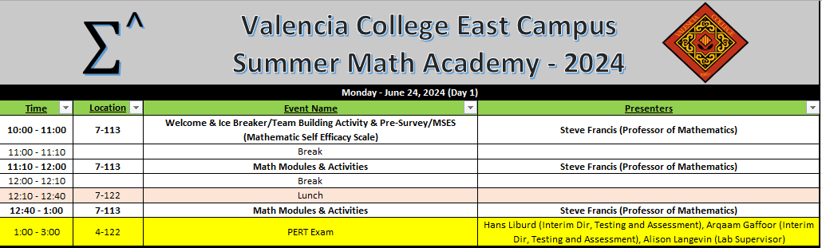
Summer Math Academy Agenda
Next 3 weeks we will have Math Module, Activities, College Success, Warmups and Math Skill Labs
Notes:
College is not just learning facts; college is about learning how to think.
Next 3 weeks we will have Math Module, Activities, College Success, Warmups and Math Skill Labs

Slide 5
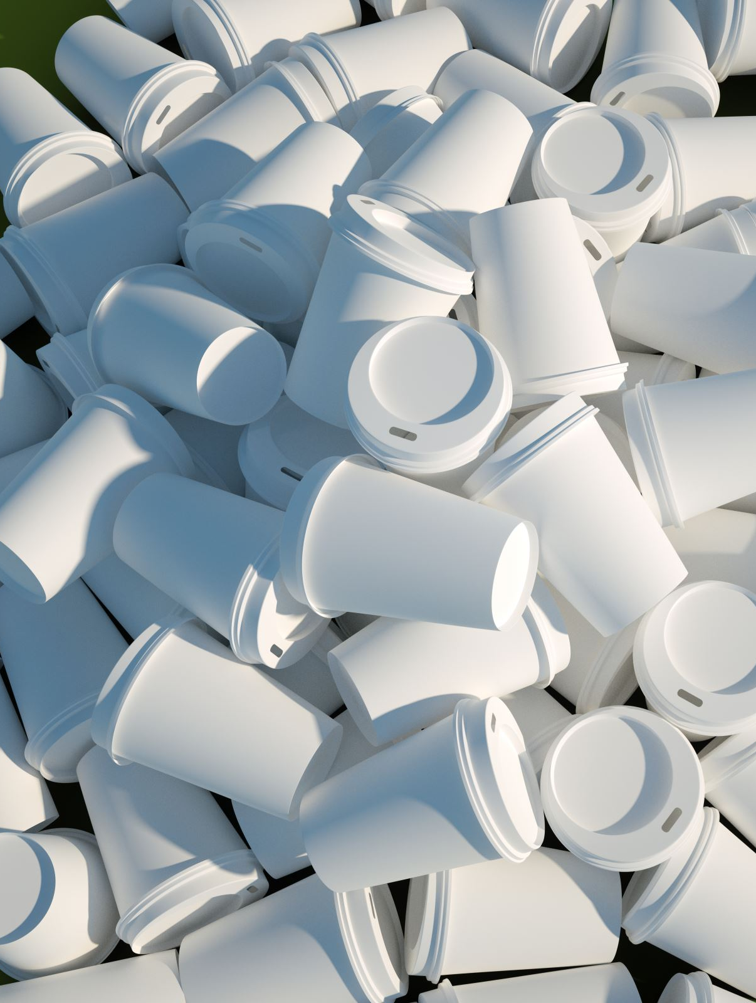
Construction Challenge
How fast can your team build a pyramid out of cups without touching the cups directly with your hands?

Slide 6
Construction Challenge
Create a tool using your kit (string/rubber band).
Rules: (when you start to build)
Each string can only be held at the very end.
You may NOT touch your partners string at anytime!
You may NOT touch your rubber band at anytime!
Your hands may NOT touch the cups anytime they are on the table
Start with 8 cups up, 8 cups down.
Pyramid layout picture in kit
If you drop your cup on the floor, you may pick it up and place it on the corner of your table to continue.
Break ANY RULE: You will have to restart!
Any Questions?

Slide 7
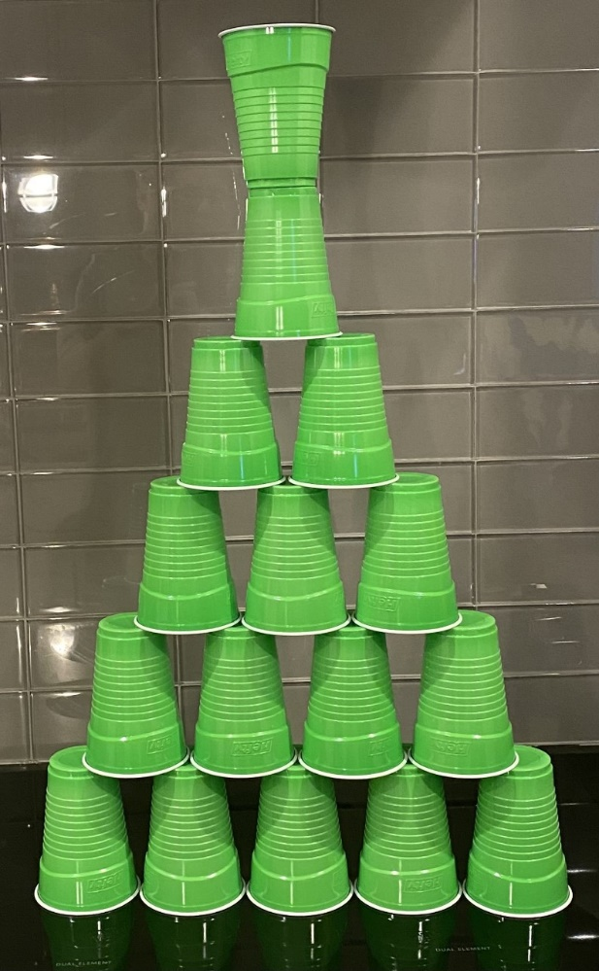
Wrap Up
What were some of the challenges your group faced during construction? How did you resolve the conflicts that came up?
What creativity and collaboration techniques did your group undertake to complete this activity successfully?
How did you support your team members through this activity?

